Slide 1
Chapter 6 Group Project
By: Nick W, Mike M, Deryk H, Chase B

Slide 2
Goals and KPIs
First call resolution rate –50 % on the phone
Average resolution time –24hrs of first contact
SLA compliance percentage – 100%
End-user satisfaction rates – 90% customer satisfaction Personnel utilization –50%
Cost per service desk ticket –
To make goals clear and reachable we will use the term SMART

Slide 3
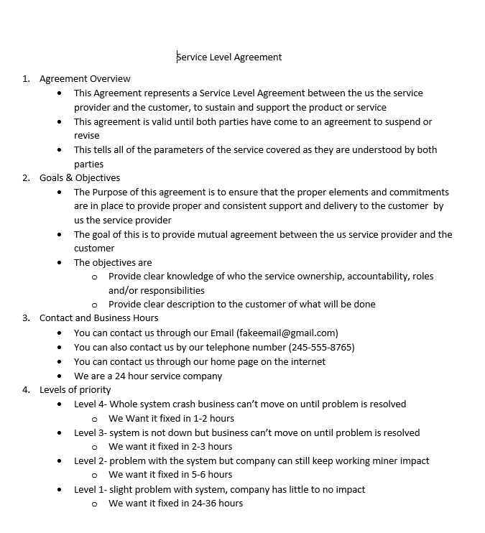
Service level Agreement
Example of our Agreement
4 parts to our agreement
4 levels of priority

Slide 4
Satisfaction Survey

Slide 5
Monitoring Checklist

